Slide 1
Attention Network Task:
BCI2000 Implementation

Slide 2
ANT Experiment Design
Practice
Block 1
Block 2
Block 3
96 Trials
96 Trials
96 Trials

Slide 3
ANT Single Trial
Cue
Target
+
+
First Fixation
Middle Fixation
Last Fixation
+
*
+
+
+
D1 =
400-1600 ms
100 ms
400 ms
Reaction
Time (RT)
3500 – RT – D1
*
+
+
+
+
*
Singla Trial Duration = 4000 ms

Slide 4
ANT Single Trial
Phase 2
Phase 4
Cue
Target
Phase 1
Phase 3
Phase 5
First Fixation
Middle Fixation
Last Fixation
+
+
+
*
+
+
+
D1 =
400-1600 ms
100 ms
400 ms
Reaction
Time (RT)
3500 – RT – D1
*
+
+
+
+
*
Singla Trial Duration = 4000 ms

Slide 5
ANT States: General
# | State Name | State Value | Value Meaning
1 | PhaseNumber | [1,2,3,4,5]
2 | TrialNumber | [1:96]

Slide 6
ANT States:In each trail
# | State Name | State Value | Value Meaning
3 | FirstFixationDuration | Random [400:1600]
4 | CueValue | [1,2,3,4]
5 | TargetValue | [1:8] | 1: congruent, top, right 2:
6 | ReactionTime | Calculated [50 : 1700]
7 | LastFixationDuration | TrialDuration – (FirstFixationDuration + CueDuration + MiddleFixationDuration + RT)

Slide 7
ANT Parameters
# | Parameter Name | Parameter Value | Parameter Value Meaning
 | TrialDuration | 4000 ms
 | FirstFixationDurationMin | 400 ms
 | FirstFixationDurationMax | 1600 ms
 | CueDuration | 100 ms
 | MiddleFixationDuration | 400 ms
 | ReactionTimeMin | 50 ms
 | ReactionTimeMax | 1700 ms
 | CueIconList | Path of cue icon
 | TargetIconList | Path of cue icon

Slide 8
ANT Parameters
# | Parameter Name | Parameter Value | Parameter Value Meaning
 | TailNum | 96
 | PracticeMode | True/Flase
 | BlockIndex | [1,10]
 | WindowWidth
 | WindowHeight
 | WindowLeft
 | WindowTop
 | BackgroundColor(Window’s)

Slide 9
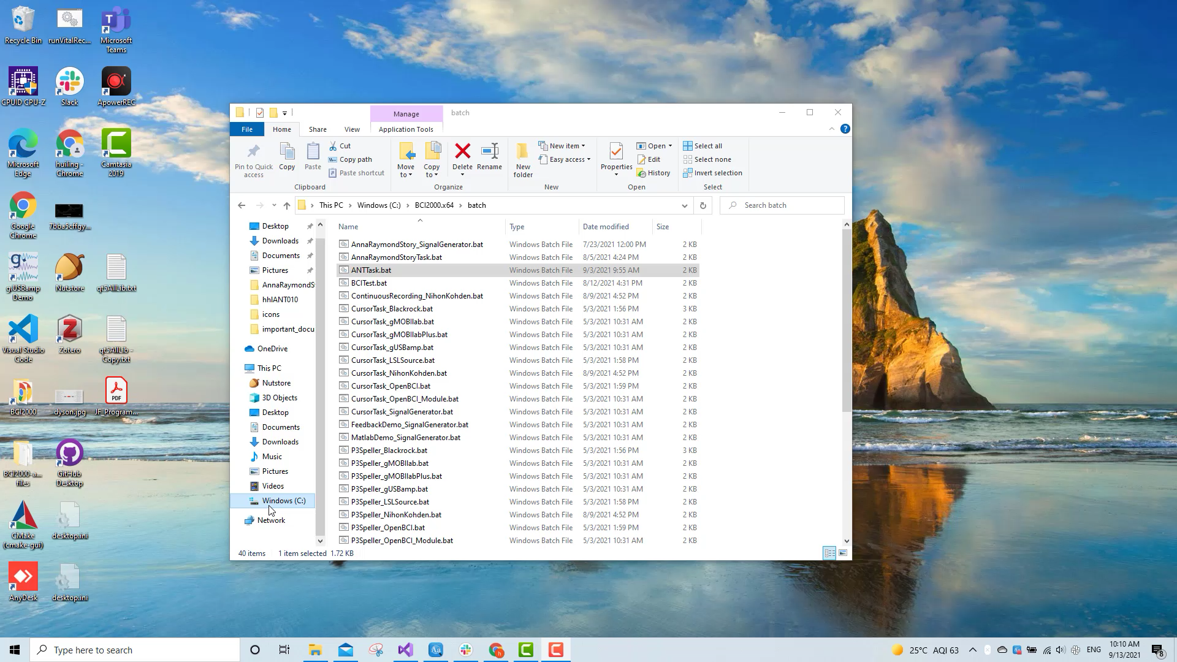
ANT Demo

